Slide 1
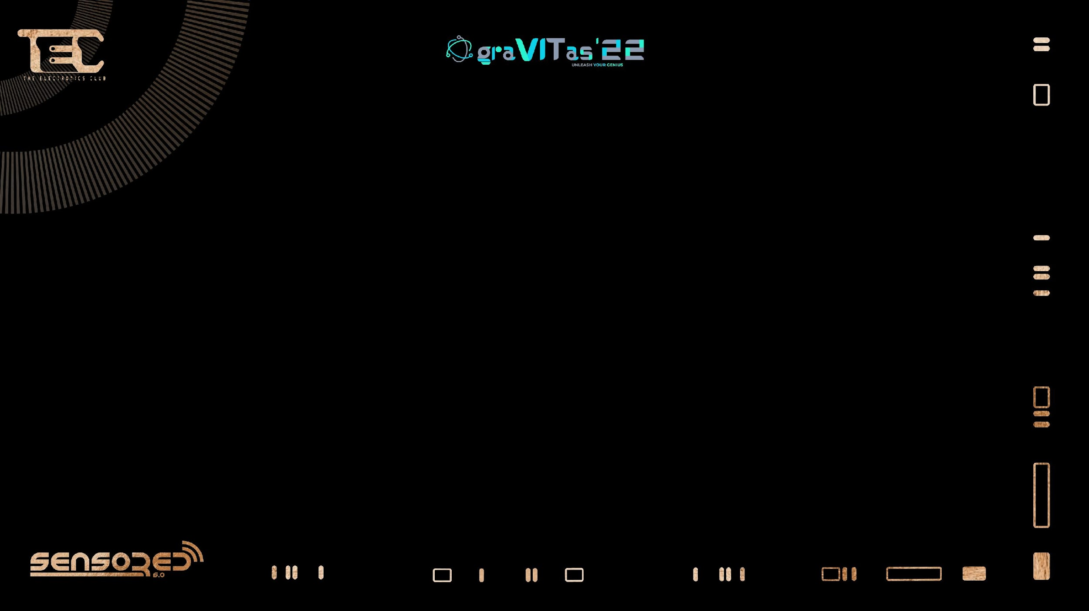

Ultrasonic Sensor

Slide 2
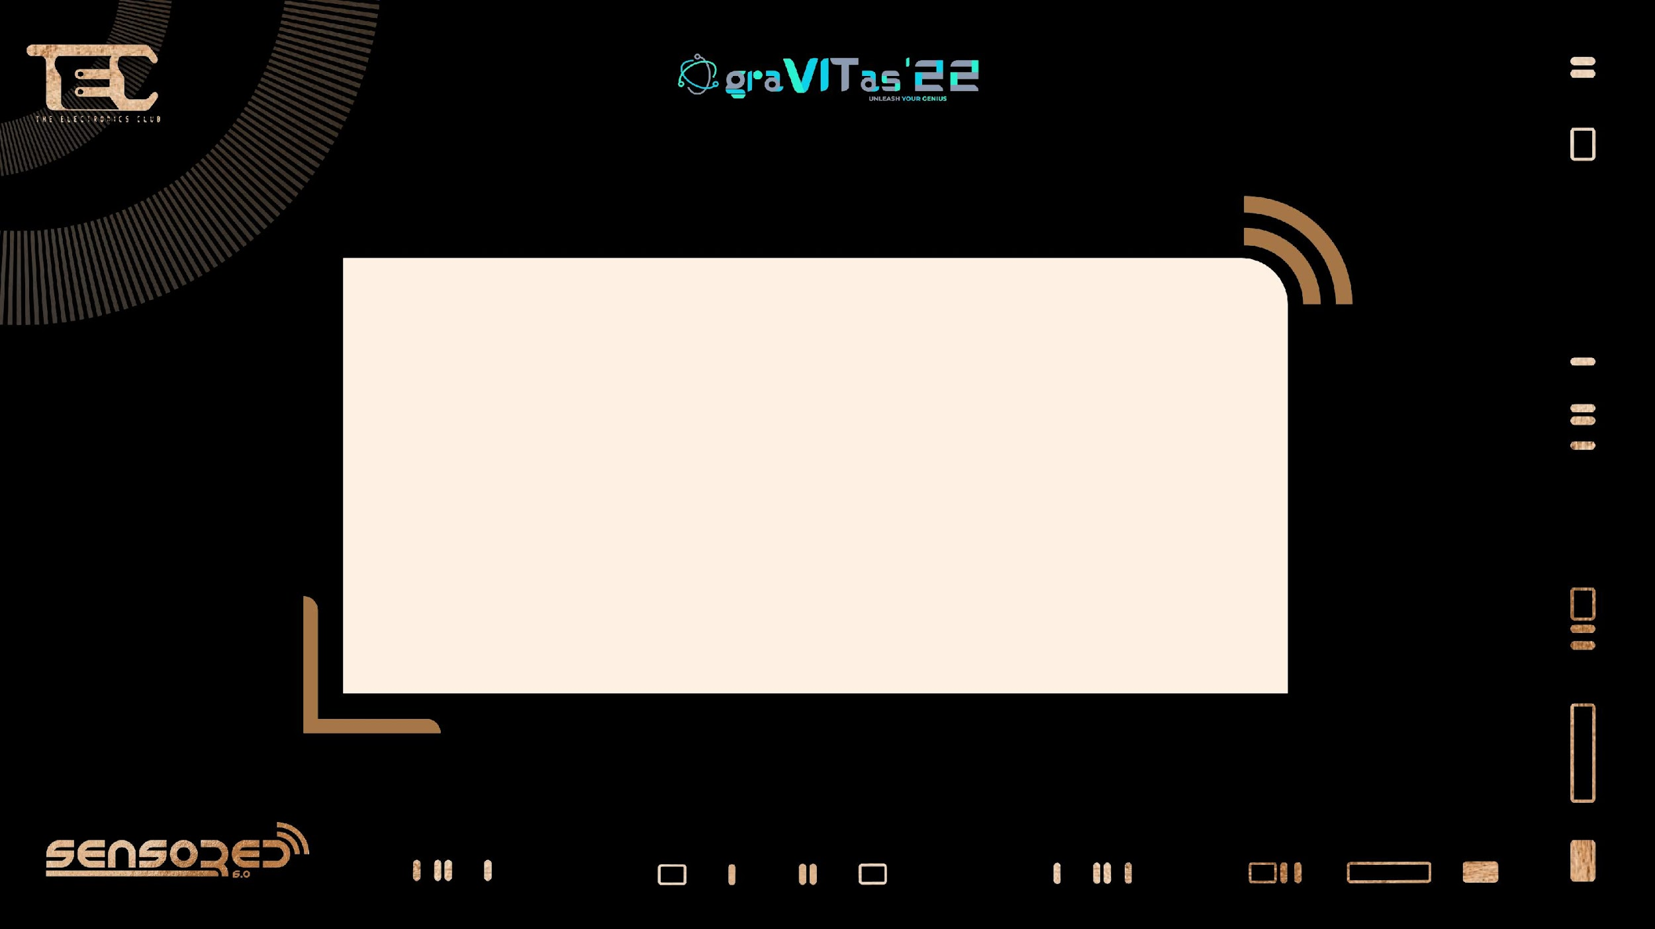

What’s up people?

Slide 3

Have any of y’all watched the Ghazi Attack?

Slide 4

How did we locate our enemies?

Slide 5

We used a technique called SONAR.

Slide 6
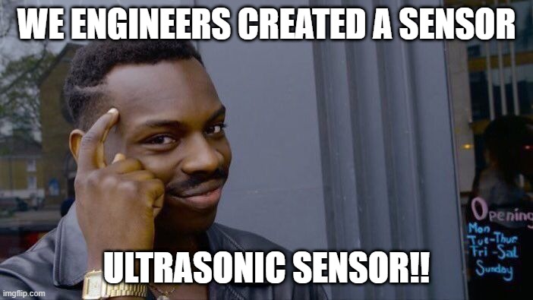
How we did it?

Slide 7


Slide 8
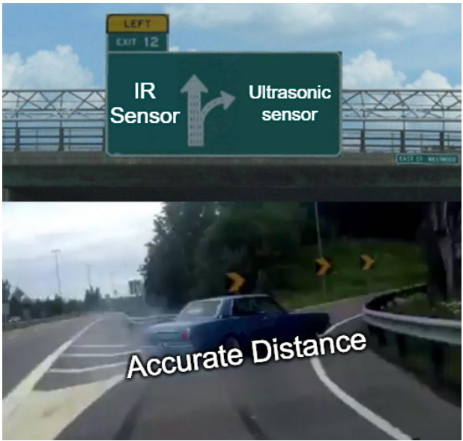
Why Ultrasonic was required?

Slide 9
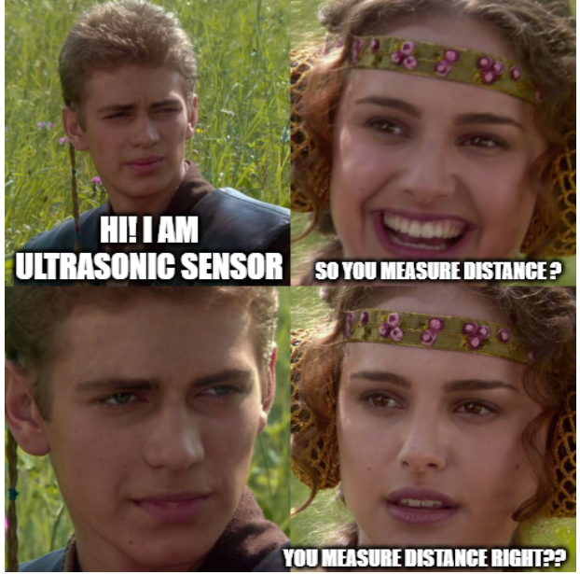
What does Ultrasonic do?

Slide 10
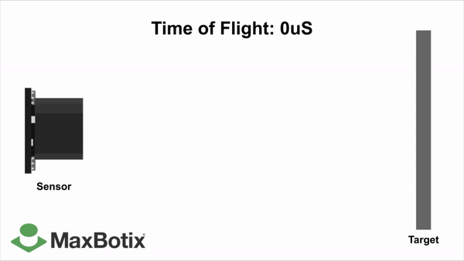
How does Ultrasonic actually do it?

Slide 11


Slide 12
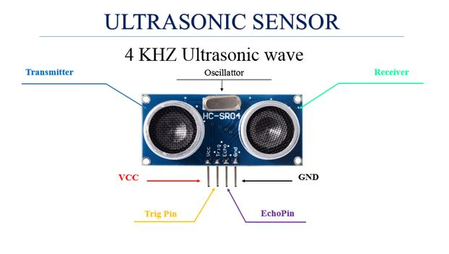
Pin Configuration

Slide 13
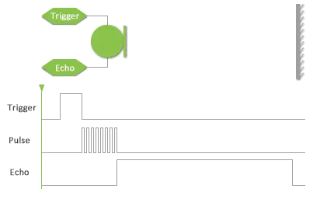

Slide 14
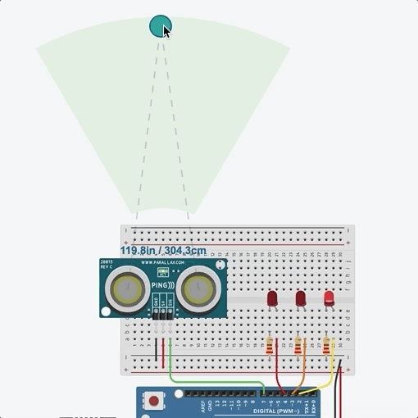
Working
Distance between the
sensor and the object
= (Speed of sound in air x Time) / 2

Slide 15
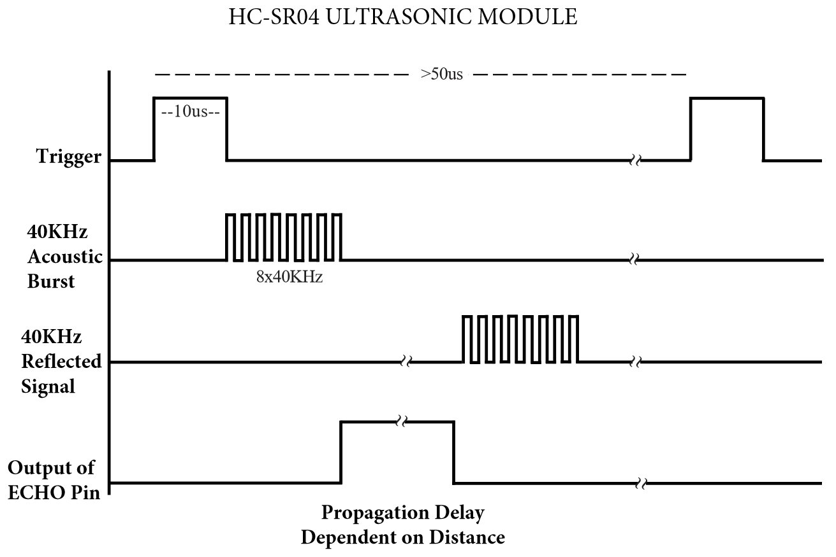
Timing Diagram

Slide 16
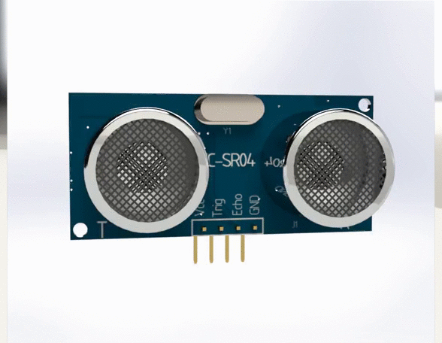
HC-SR04 Ultrasonic Sensor
Operating Voltage | 5V DC
Operating Current | 15mA
Operating Frequency | 40KHz
Min Range | 2cm / 1 inch
Max Range | 400cm / 13 feet
Effectual Angle | <15°
Dimension | 45 x 20 x 15mm

Slide 17
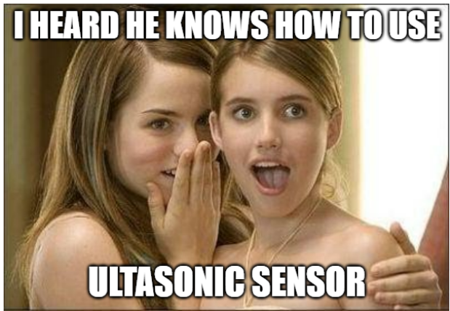
Applications

Slide 18
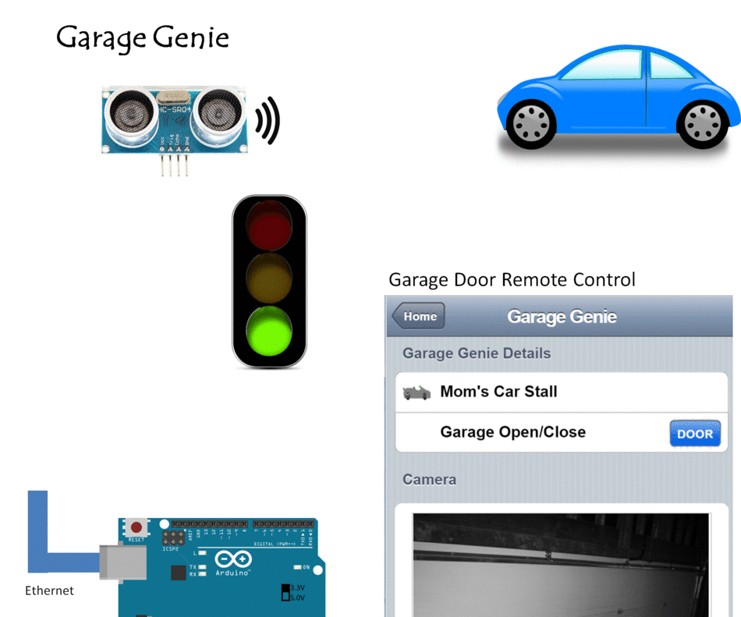
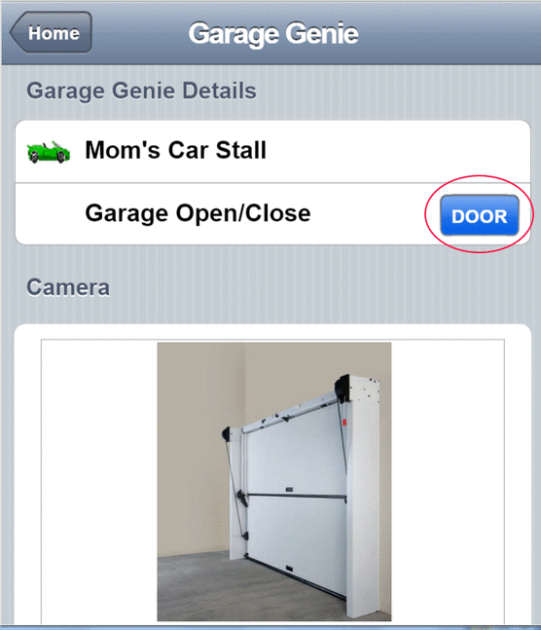
Garage Genie

Slide 19
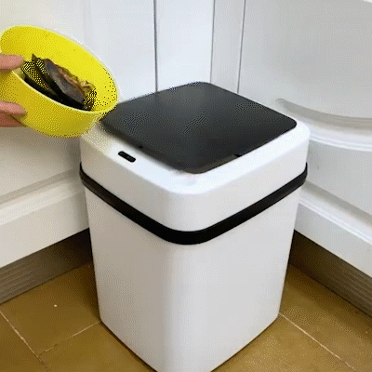
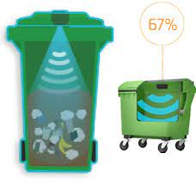
Smart Dustbin

Slide 20
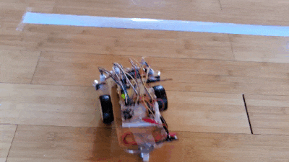
Obstacle Avoiding Robot

Slide 21

Time to code!!!

Slide 22
Arduino Code
// defines pins numbers
const int trigPin = 6;
const int echoPin = 3;
// defines variables
long duration;
int distance;
void setup() {
pinMode(trigPin, OUTPUT); // Sets the trigPin as an Output
pinMode(echoPin, INPUT); // Sets the echoPin as an Input
Serial.begin(9600); // Starts the serial communication
}

Slide 23
void loop() {
// Clears the trigPin
digitalWrite(trigPin, LOW);
delayMicroseconds(2); // Sets the trigPin on HIGH state for 10 micro seconds
digitalWrite(trigPin, HIGH);
delayMicroseconds(10);
digitalWrite(trigPin, LOW); // Reads the echoPin, returns the sound wave travel time in microseconds
duration = pulseIn(echoPin, HIGH); // Calculating the distance
distance = duration * 0.034 / 2; // Prints the distance on the Serial Monitor
Serial.print("Distance: ");
Serial.println(distance);
Serial.print(“ cm”);
}

Slide 24
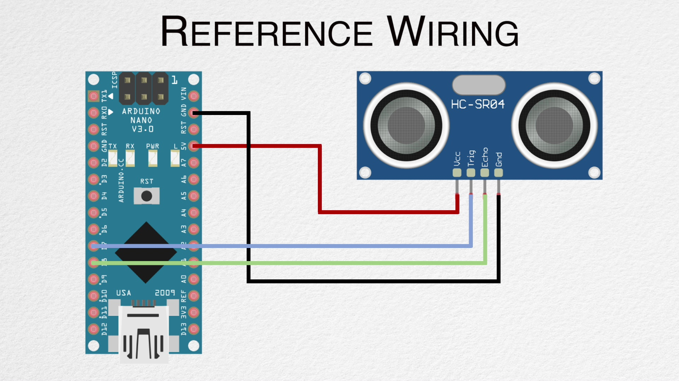
Circuit Diagram
Connect the +5V pin to +5v on your Arduino board.
Connect Trigger to digital pin 6 on your Arduino board.
Connect Echo to digital pin 3 on your Arduino board.
Connect GND with GND on Arduino.

Slide 25

THANK YOU!
Speakers: Aryan Saxena and Utsav Bajaj

